Slide 1
Unsupervised k-Means clustering algorithm
Mohammad Shoaei
Feb. 2022

Slide 2
Table of contents
Clustering Approaches
Unsupervised K-Means
U-K-Means clustering algorithm
Implementation
Experimental results

Slide 3
Clustering Approaches

Slide 4
Clustering Approaches
Probability model-based
Mixture models
Nonparametric
Hierarchical
Partitional
Notes:
1- The probability model-based approaches follow that the data points are from a mixture probability model.
In model-based approaches, the expectation and maximization (EM) algorithm is the most used
2- For nonparametric approaches, clustering methods are mostly based on an objective function of similarity or dissimilarity measures, and these can be divided into hierarchical and partitional methods where partitional methods are the most used

Slide 5
Unsupervised k-means

Slide 6
Unsupervised k-means
Is K-Means algorithm a true unsupervised algorithm?
What is the major problem of K-Means algorithm and its extension?
Notes:
1- Explain why K-Means is not unsupervised
2- Explain that initialization affects the algorithm and also the number of clusters MUST be defined

Slide 7
Unsupervised k-means
X-Means
an algorithm to estimate the number of clusters
Unsupervised K-Means Clustering Algorithm (U-K-Means)
New proposed algorithm which finds the number of clusters automatically
Notes:
For estimation the number of clusters, Pelleg and Moore [23] extended k-means, called X-means, by making local decisions for cluster centers in each iteration of k-means with splitting themselves to get better clustering.
We need to specify a range of cluster numbers in which the true cluster number reasonably lies and then a model selection, such as BIC or AIC, is used to do the splitting process

Slide 8
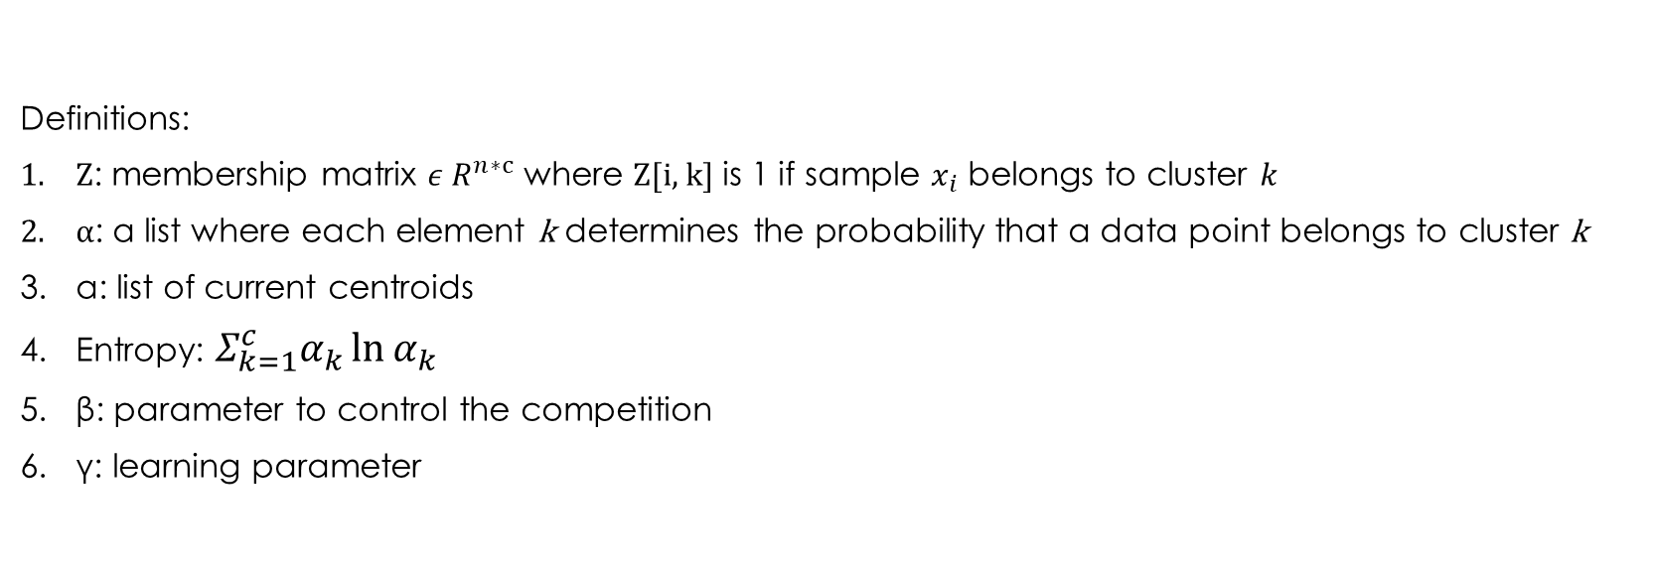
U-K-Means
Definitions:
Z: membership matrix $ε R^{n∗c}$ where Z[i, k] is 1 if sample $x_{i}$ belongs to cluster $k$
α: a list where each element k determines the probability that a data point belongs to cluster k
a: list of current centroids
Entropy: $Σ_{k=1}^{c}α_{k}\ln{α_{k}}$
β: parameter to control the competition
γ: learning parameter
Notes:
When αk = 1/c,∀k = 1,2,...,c, we say that there is no information about αk. At this point, we have the entropy achieve the maximum value. Therefore, we add this term to the k-means objective function J(z,A) as a penalty.

Slide 9
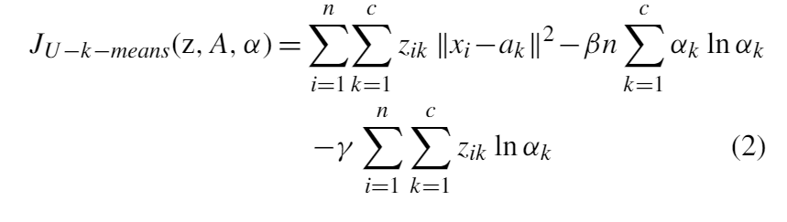
U-K-Means
Objective Function:
Notes:
This is the Objective function but we do not approach this function directly

Slide 10
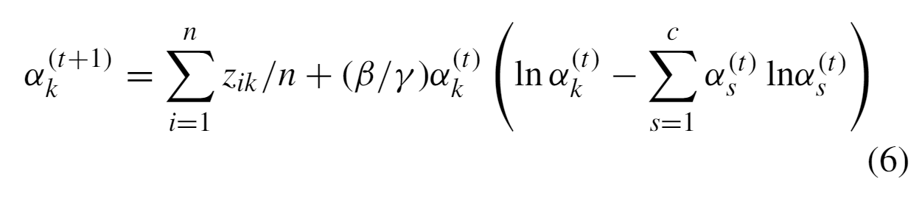
U-K-Means
Updating the probabilities:
Notes:
Most important part of the algorithm

Slide 11
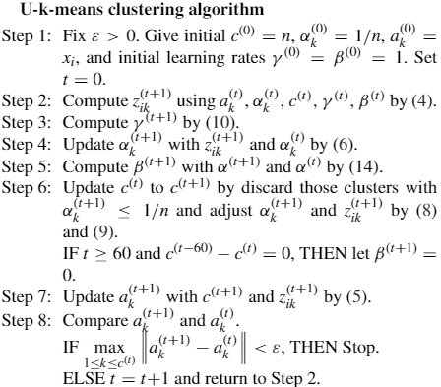
U-K-Means

Slide 12
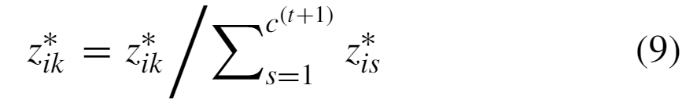
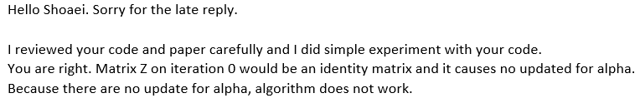
U-K-Means
Notable problems of the paper:
Matrix Z will be an identity matrix on 0th iteration
Recall that it is not mentioned which β and γ should be used to update α
Inconsistent criteria for updating the number of clusters
Despite strictly defining that matrix Z has either value 1 or 0 but algorithm (9) makes this matrix contain other values than 0 or 1.

Slide 13
Implementation of U-K-Means

Slide 14
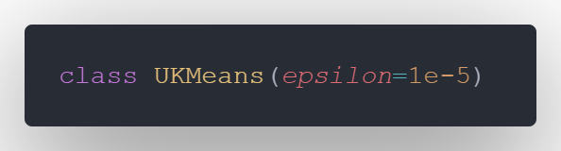
Implementation
The Algorithm is defined as a Python class described below

Slide 15
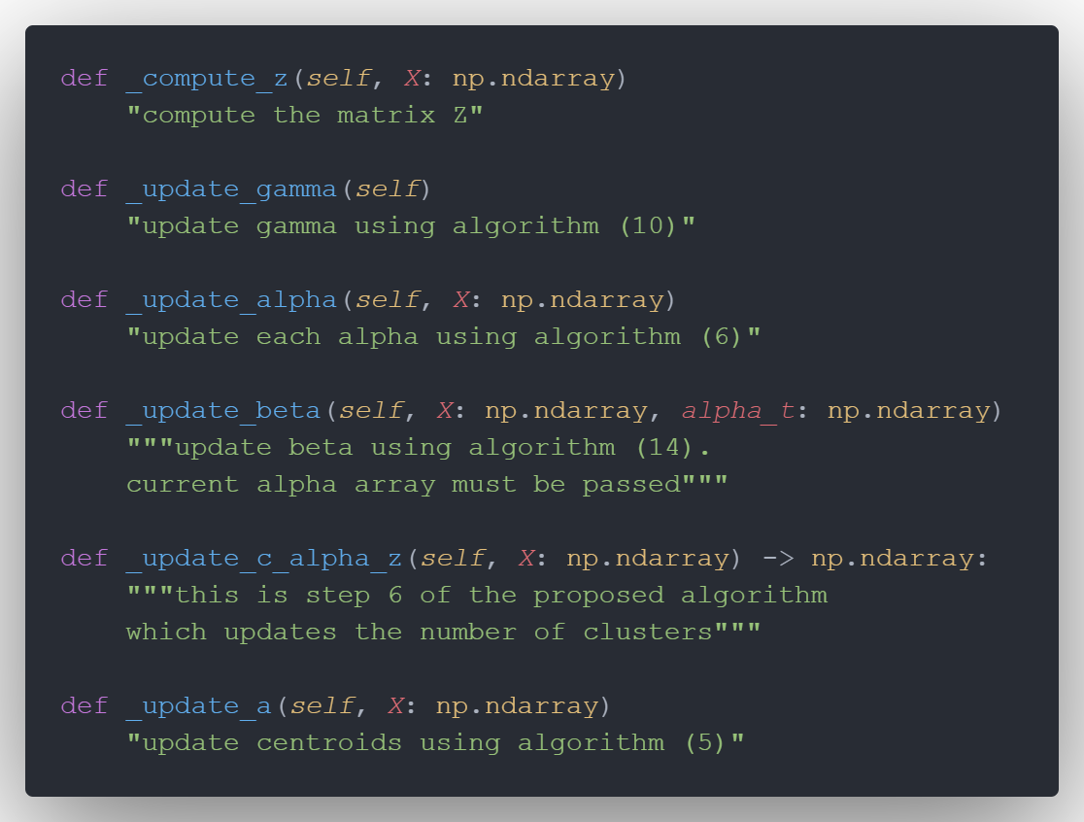
Implementation
Methods:

Slide 16
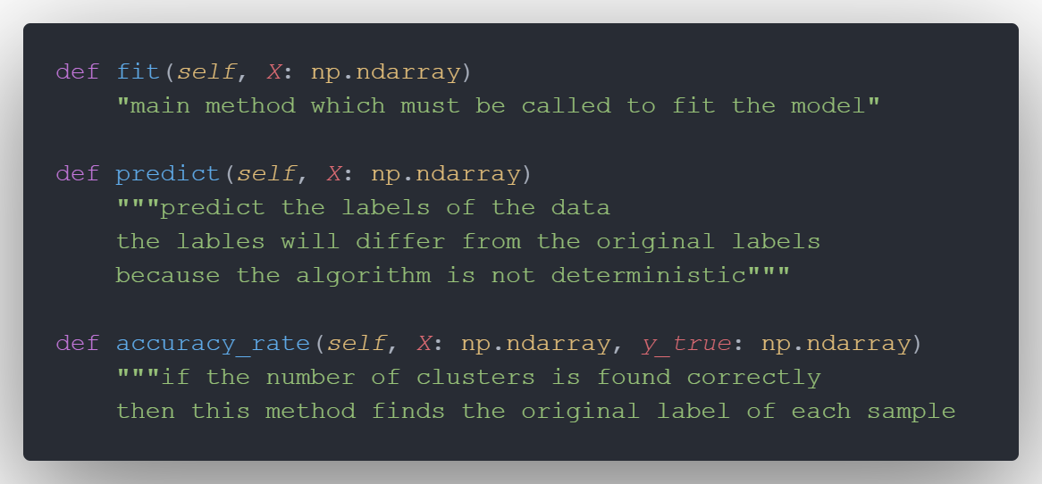
Implementation
Methods:

Slide 17
Experimental results

Slide 18
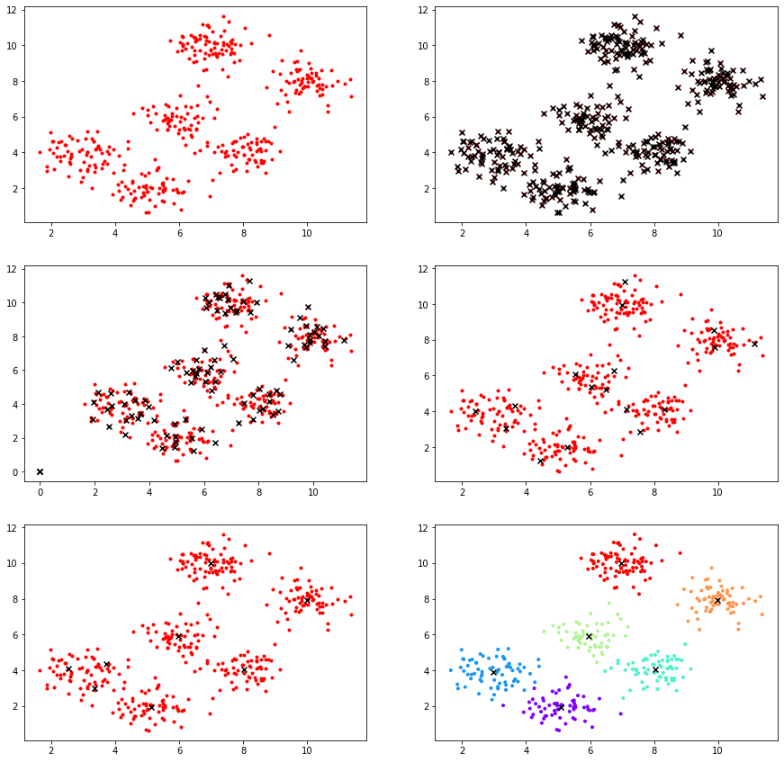
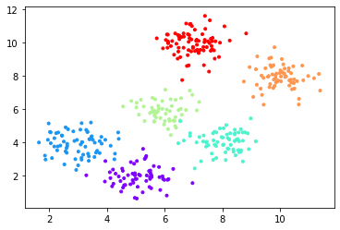
Experimental results Example 1
Without Noise
Iteration = 13
C* = 6
AR = 0.99
With Noise
Iteration = 20
C* = 6
AR = 0.968

Slide 19
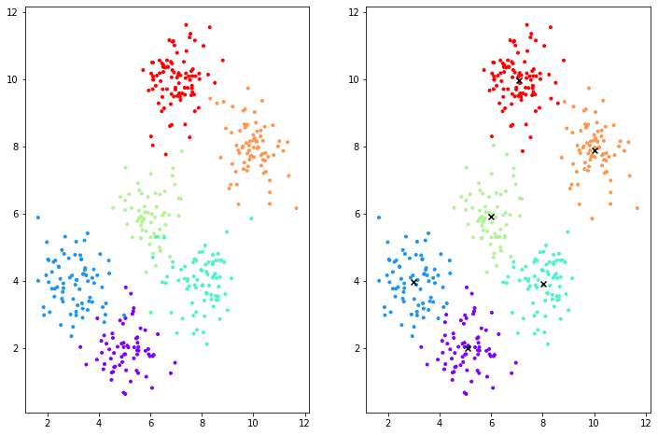
Experimental results Example 1

Slide 20
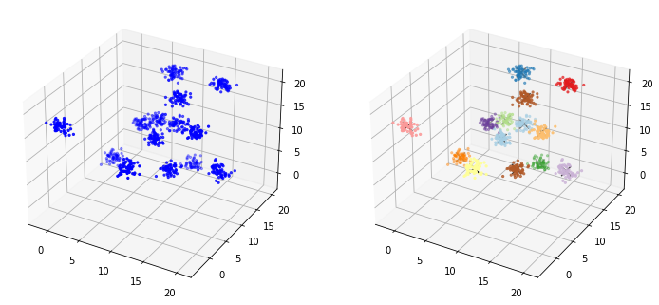
Experimental results Example 2
Iteration = 20
C* = 14
AR = 0.99625
3-variate, 14-components

Slide 21
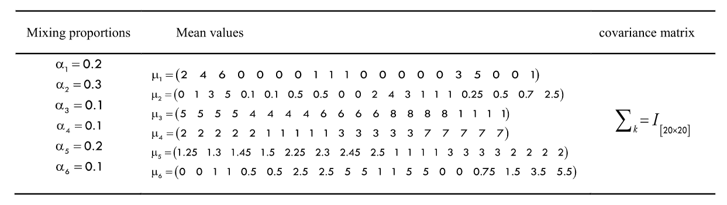
Experimental results Example 3
20-variate, 6-components
900 samples
Result:
Iteration = 11
C* = 6
AR = 1.0

Slide 22
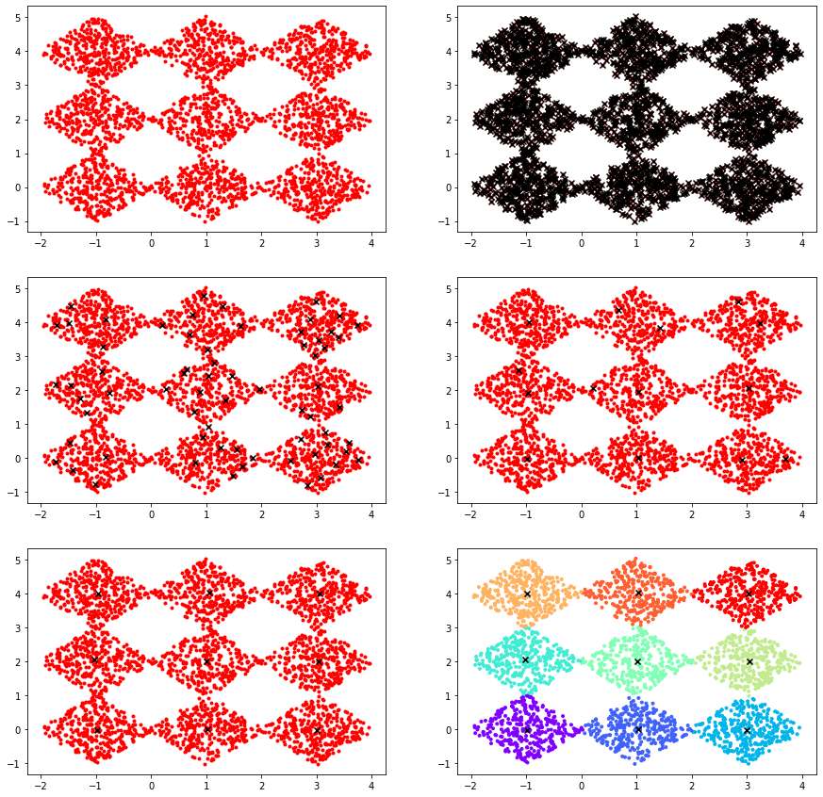
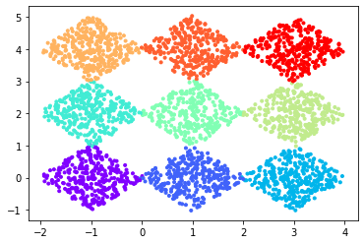
Experimental results Example 4
Iteration = 11
C* = 9
AR = 0.996

Slide 23
Experimental results Example 5
Dataset | True C | C* | AR
Iris | 3 | 3 | 0.8866
Seeds | 3 | 3 | 0.8857
Australian | 2 | 1 | -
Flowmeter D | 4 | 2 | -
Sonar (*)
Wine | 3 | 3 | 0.6067
Horse | 2 | 1 | -
Waveform V1 | 3 | 4 | -
*: dataset was not found in UCI repository

Slide 24
Experimental results Example 6
Dataset | True C | C* | AR
SPECT | 2 | 2 | 0.4385
PARKINSON | 2 | 2 | 0.6974
WPBC | 2 | 2 | 0.8541
COLON(*)
LUNG (*)
Nci9(*)
*: dataset was not found in UCI repository

Slide 25
Experimental results Example 7
It is unclear how 135 out of 165 images were selected.
The result in the following table are using the first 9 images of each person.
Tweaking the number of images changed the number of clusters with a maximum 6 cluster for selecting the first 7
Dataset | True C | C* | AR | Paper C*
Yale Face 32x32 | 15 | 2 | - | 16

Slide 26
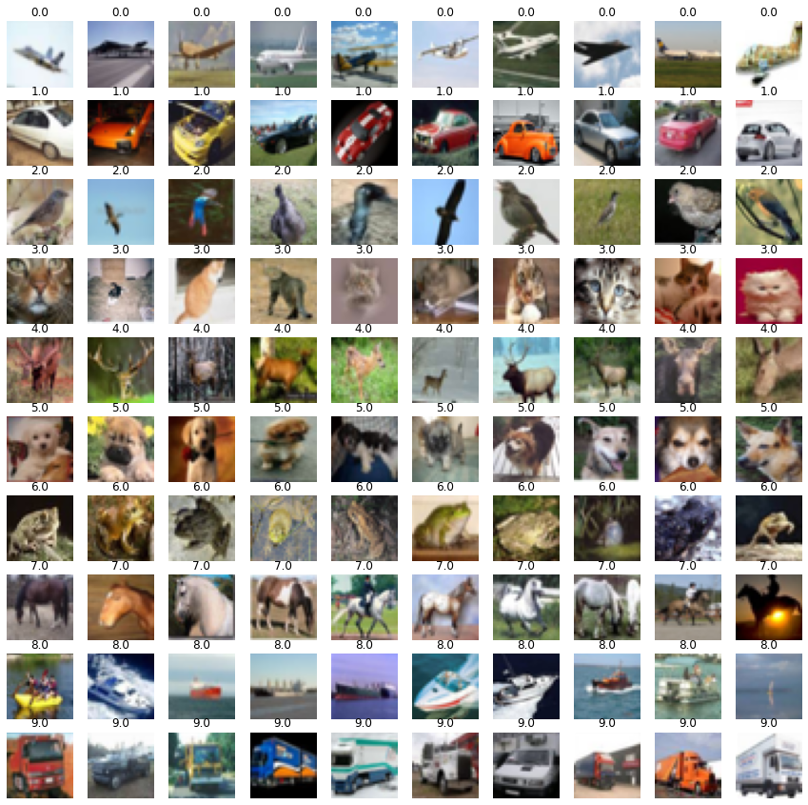
Experimental results Example 8
Dataset | True C | C* | AR | Paper C
CIFAR-10 | 10 | 8 | - | 10
The paper does display the sample that were chosen from the dataset
It is stated that there are 10 image per class
The image displaying the samples used in paper contains 11 pictures from horse class which affects the authenticity of results achieved by the paper

Slide 27
Experimental results Performance
Dataset | Time (s)
Synthetic Dataset
Example 1 | 2.49
Example 2 | 9.07
Example 3 | 10.3
Example 4 | 74
Dataset | Time (s)
UCI Dataset
Iris | 0.251
Seeds | 0.682
Australian | 6.31
Flowmeter D | 0.923
Sonar(*)
Wine | 0.557
Horse(*)
Waveform | 240
Dataset | Time (s)
UCI Dataset
Iris | 0.251
Seeds | 0.682
Australian | 6.31
Flowmeter D | 0.923
Sonar(*)
Wine | 0.557
Horse(*)
Waveform | 240

Slide 28
Experimental results Performance
Dataset | Time (s)
Medical Dataset
SPECT | 0.440
Parkinson | 1.08
WPBC | 5.99
Colon(*)
LUNG(*)
Nci9(*)
Dataset | Time (s)
Image Dataset
Yale Face 32x32 | 0.349
CIFAR-10 | 0.218

